Slide 1
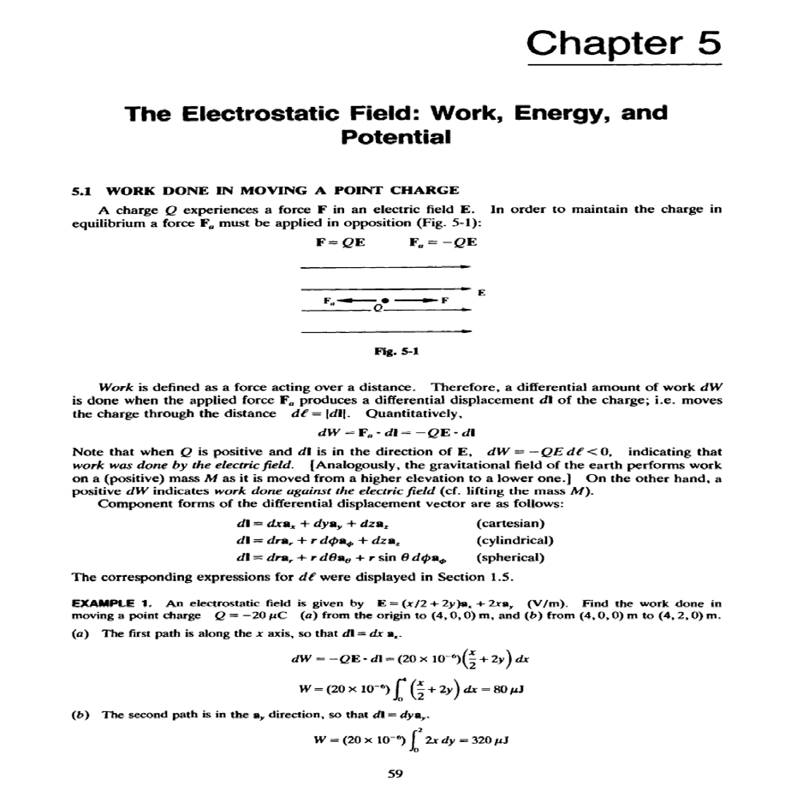
Lecture Five

Slide 2
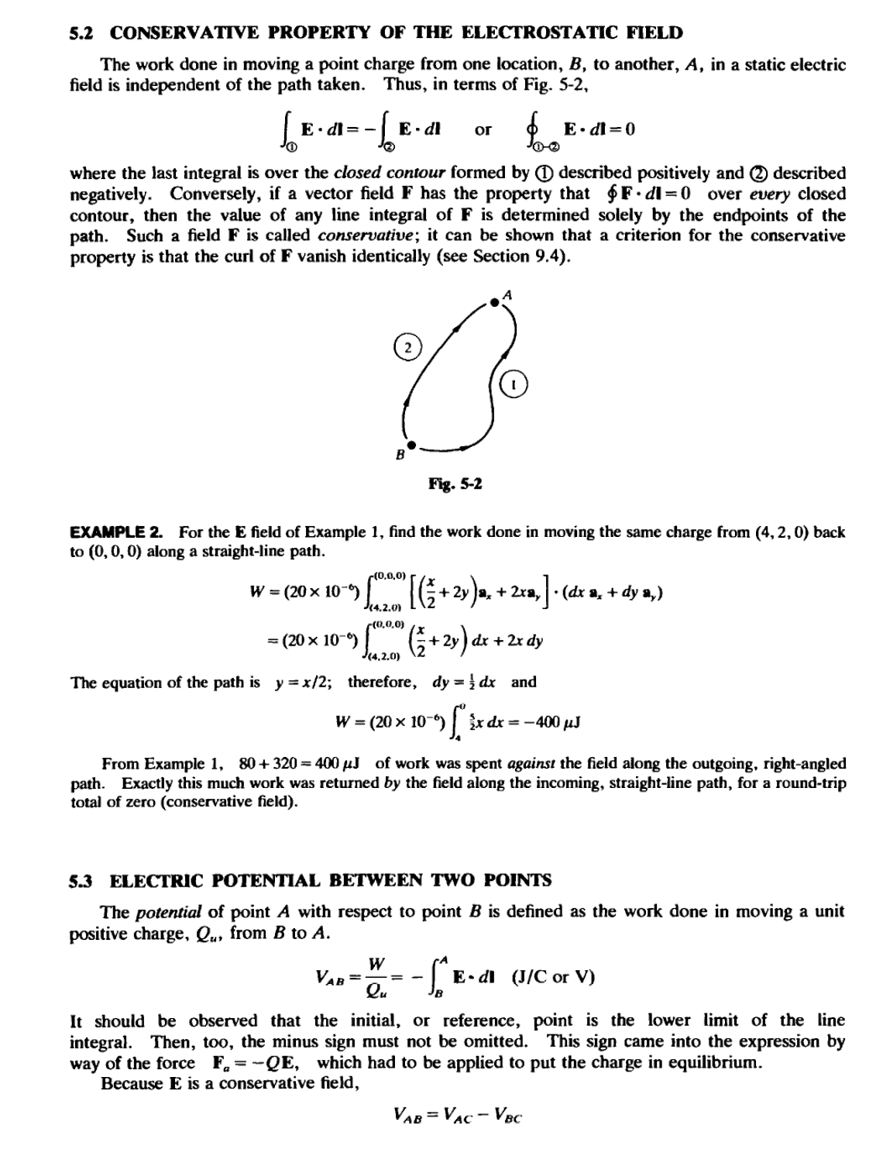
Lecture Five

Slide 3
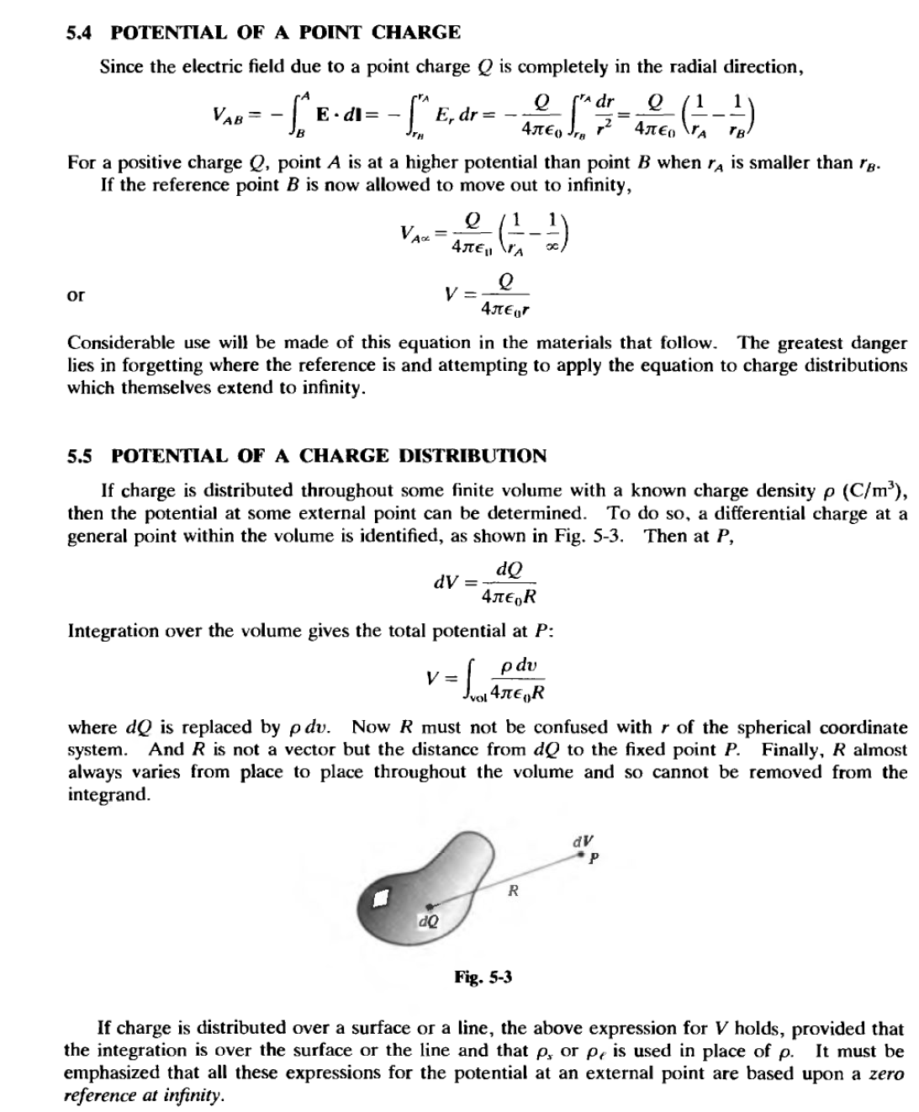
Lecture Five

Slide 4
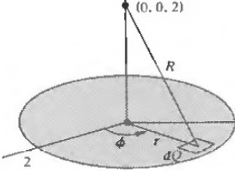
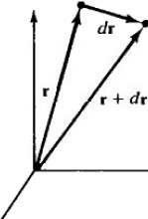
Lecture Five
EXAMPLE 3. A total charge of nC is uniformly distributed in the form of a circular disk of radius 2m. Find the potential due to this charge at a point on the axis, 2m from the disk. Compare this potential with that which results if all of the charge is at the center of the disk .
Using Fig. 5-4,
Q w-"
R =V4+rl (m)
_{P} =-=- C/m²
A 3n
V =30i2n 12 rdr df/> = 49.7V
and
n o o v4 +r²
With the total charge at the center of the disk, the expression for the potential of a point charge applies:
Q
;oX 10·
=60V
V =--=
4JrE₀z 4n(10 ⁹/36rr)2
tlg. 5-4
5.6 GRADIENT
At this point another operation of vector analysis is introduced. Figure 5-S(a) shows two neighboring points. M and N, of the region in which a scalar function V is defined. The vector separation of the two points is
dr = dxax +dyay +dza,
M<x.y,z)
z
N(x +dx,y + dy,z + dz)
Y(x,y,z) •c2
y
V (x,y, z) -c₁
y
(a)
)(
(b)
Ftg. s-s

Slide 5
Lecture Five

Slide 6
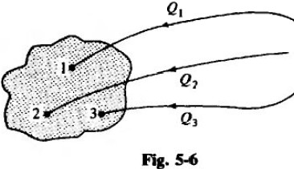
Lecture Five
EXAMPLE 4. In spherical coordinates and relative to infinity, the potential in the region r >0 surrounding
a point charge Q is V = Q/4rr€0r. Hence,
E= -VV= _._{a}!_{r}_( fL)a =_g_a,
4.n£oT ' 4rr£or
in agreement with Coulomb's law. (V is obtained in principle by integrating E; so it is not surprising that differentiation of V gives back E.)
5.8 ENERGY IN STADC ELECTRIC FlELDS
Consider the work required to assemble, charge by charge, a distribution of n = 3 point charges. The region is assumed initially to be charge-free and with E =0 throughout.
Referring to Fig. 5-6, the work required to place the first charge. Q, into position 1 is
zero. Then, when Q₂ is moved toward the region, work equal to the product of this charge and the potential due to Q, is required . The total work to position the three charges is
WE = W₁ + W₂ + W₃
= 0+ (QzV2, ,) + (Q3V3,1 + Q3V3.2)
The potential .₁ must be read "the potential at point 2 due to charge Q, at position l." (This rather unusual notation will not appear again in this book .) The work WE is the energy stored in the electric field of the charge distribition . (See Problem 5.17 for a comment on this identification.) Now if the three charges were brought into place in reverse order, the total work would be
WE= Wl+ W2 + w,
=0 + (Q₂ V2.3) + (Q₁V₁.₃ + Q, Y1.2)
When the two expressions above are added, the result is twice the stored energy:
2WE = Q,(Vt.2 + Vu) + Qz(Vz.t + Vu) + Q₃(V₃,, + V3.2)
The term Q₁(V₁.₂ + V,,₃) was the work done against the fields of Q₂ and Q₃, the only other charges in the region . Hence, V1.2 + Vl.l = V₁, the potential at position 1. Then
2WE = Q, V, + Q2V2 + Q3V3
and
for a region containing n point charges. For a region with a charge density p (C/m³ the summation
)
becomes an integration,
WE= f pVdv
Other forms (see Problem 5.12) of the expression for stored energy are
WE =2¹f <EE² dv
00

